Slide 1
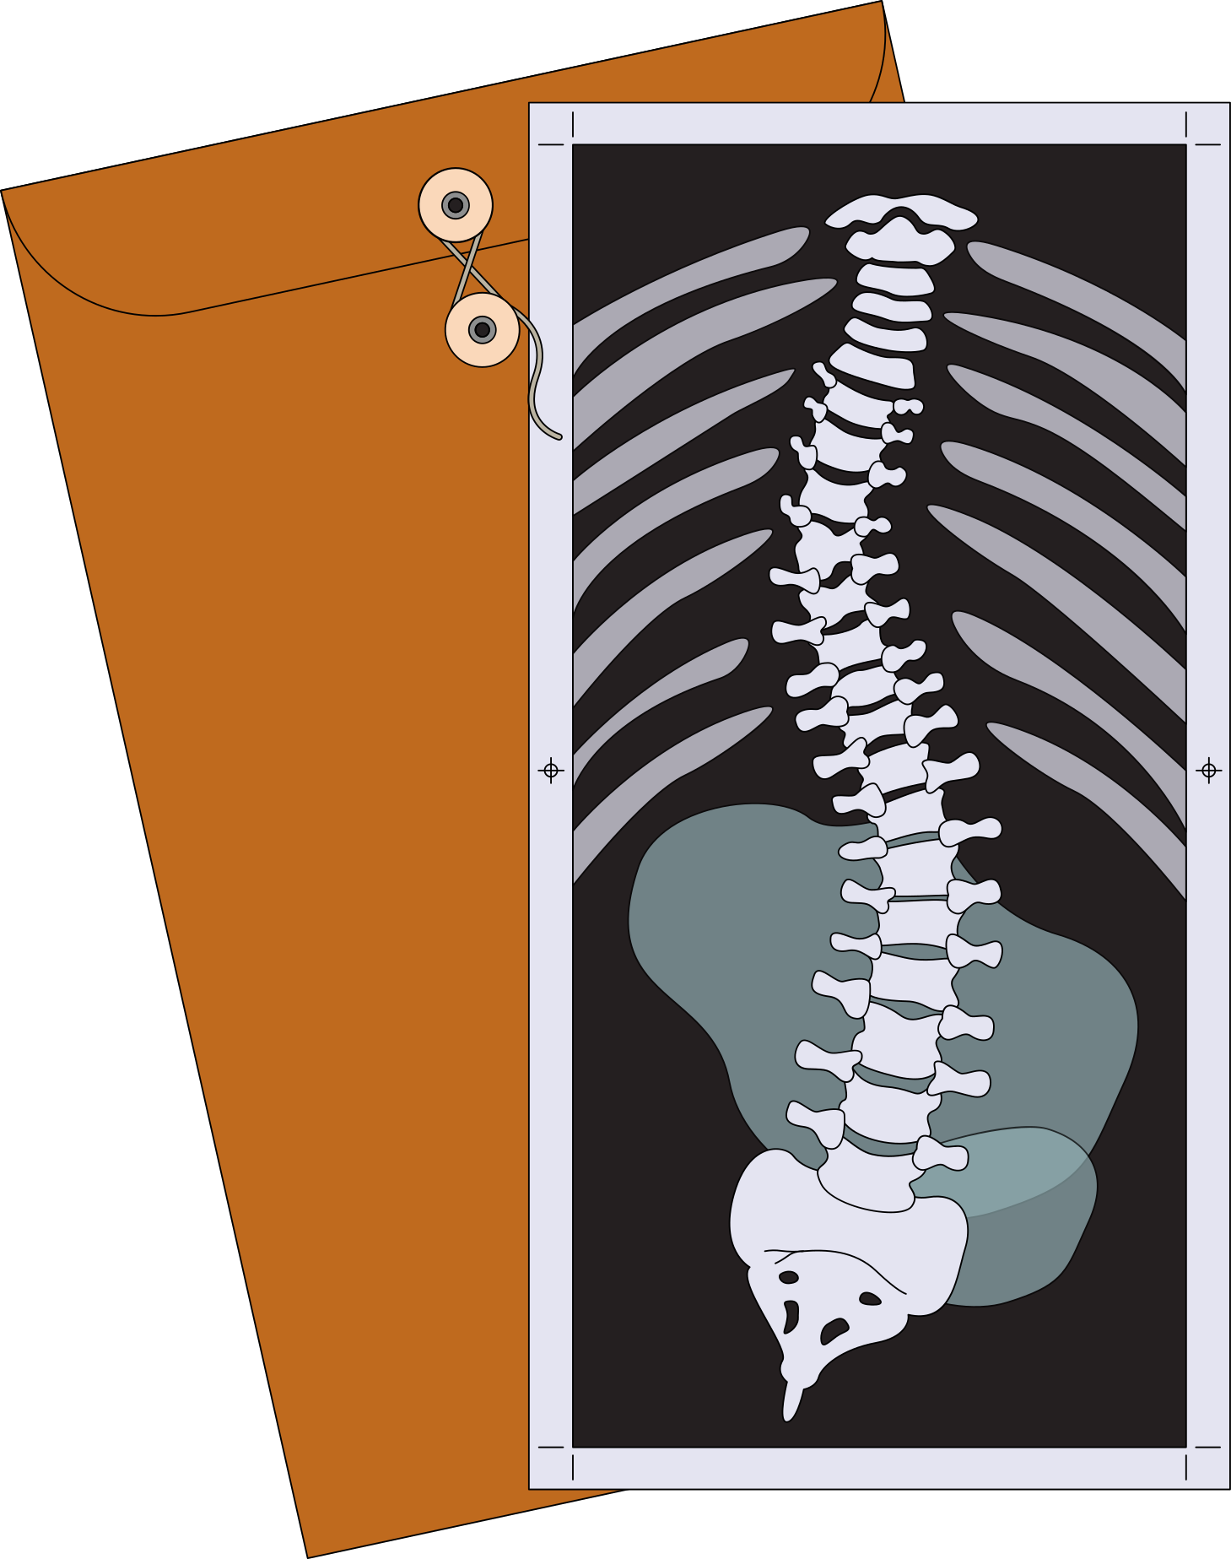
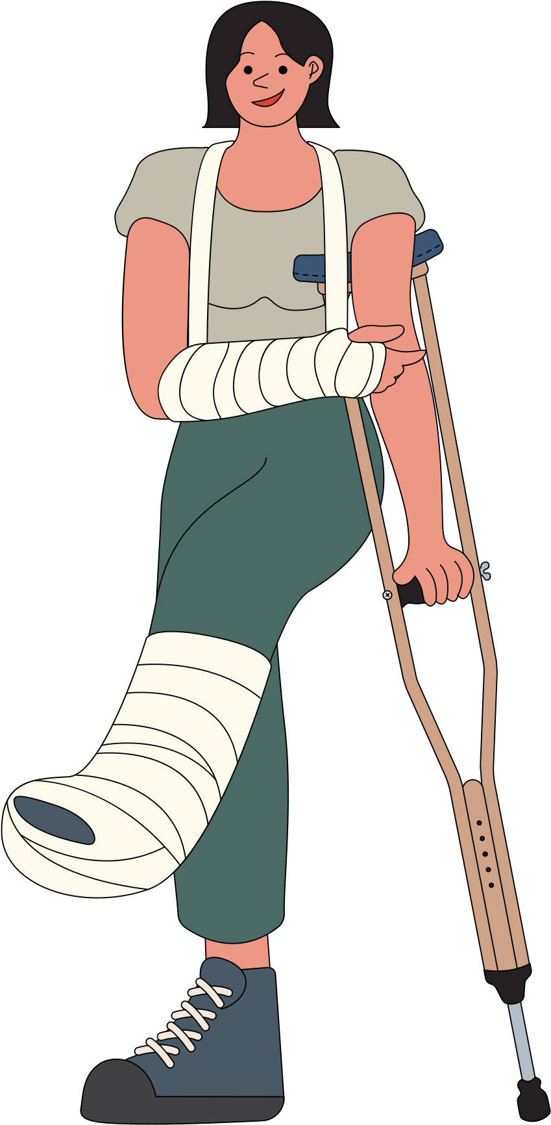
GESTURE RECOGNITION FOR MOTOR DISABILITIES
ARTIFICIAL INTELLIGENCE PROJECT MANAGEMENT
GROUP F

Slide 2
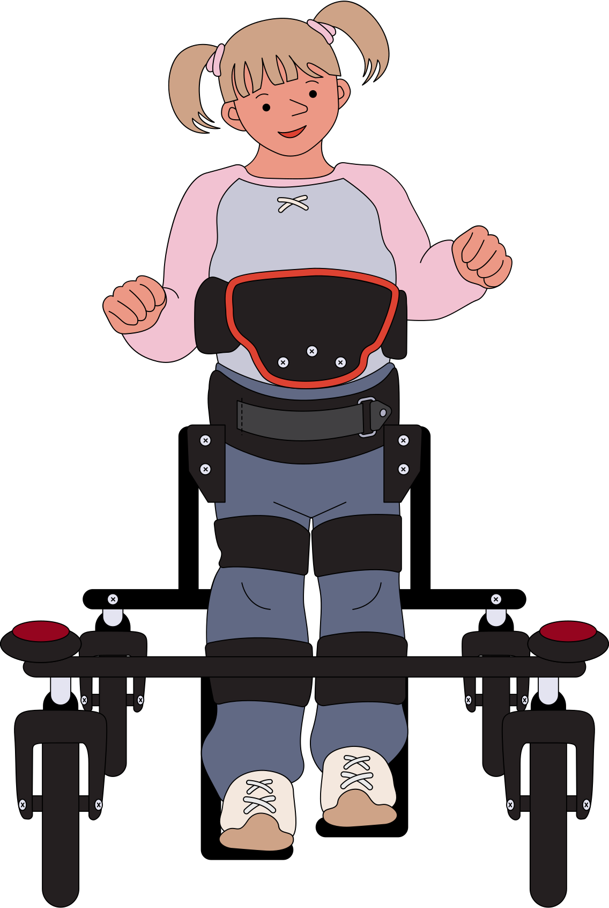
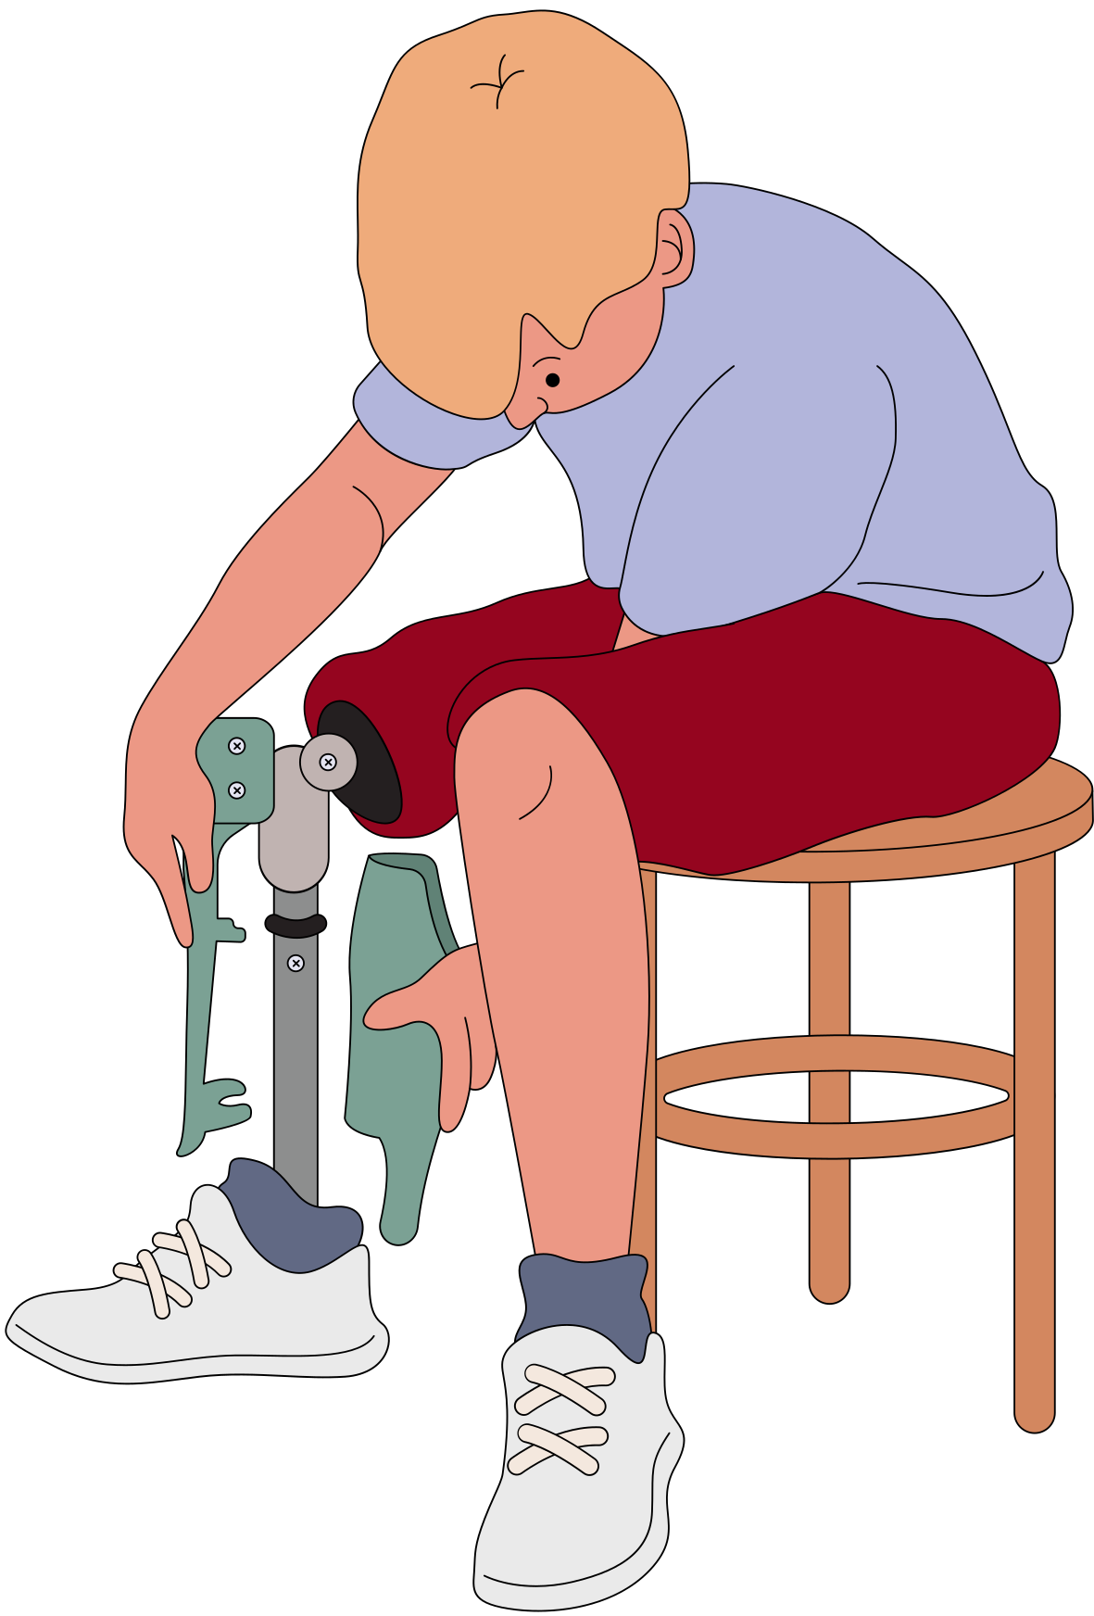
List of members
SITI AZALIA BINTI MEHAT | B032110338
PRIYADHARSHNI | B032110285
ALIYAH NAJMA BINTI NADZRI | B032110398
MARSHITAH BINTI AZHAR | B032110355

Slide 3
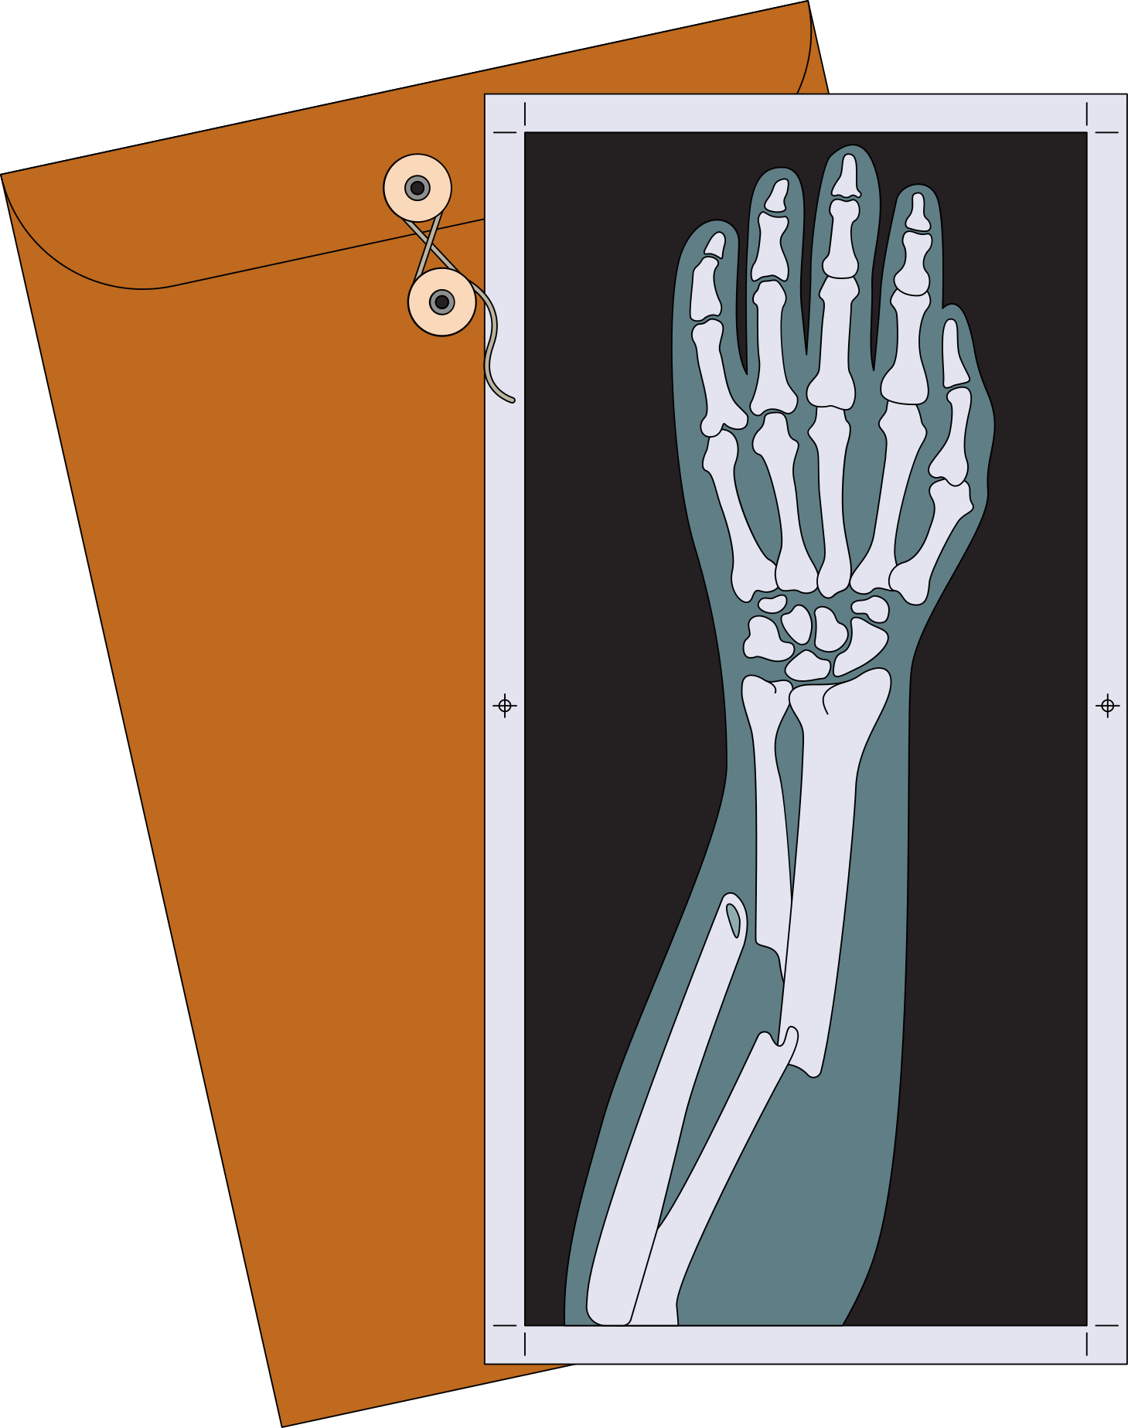
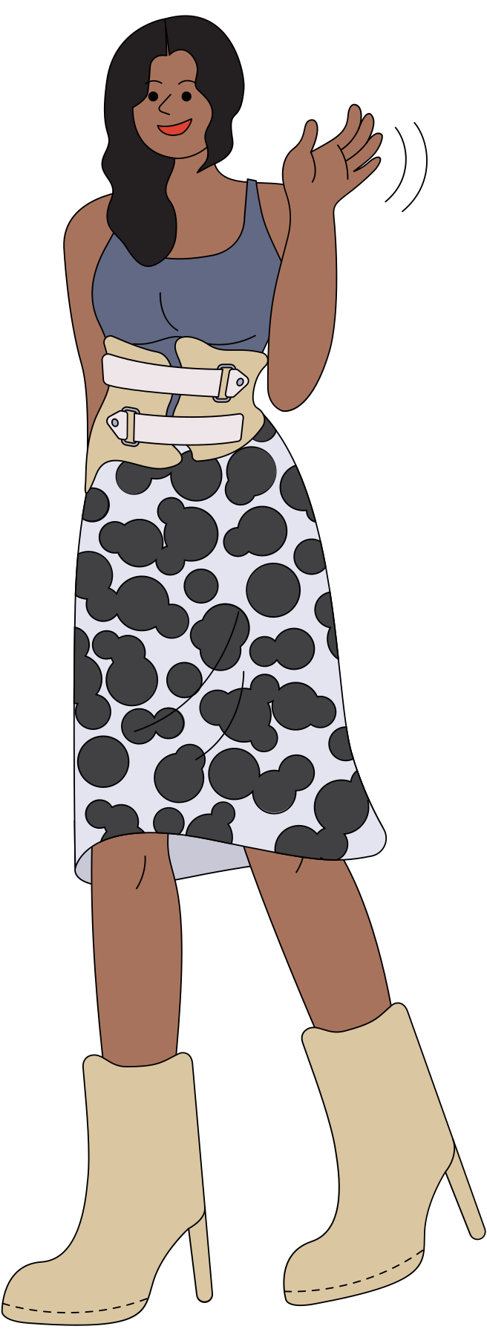
List of contents
Current Problem
Issue in the Spesific Community
Target Community
Solution with Artificial Intelligence
Key Components of the Solution
Key Components of the Business Case

Slide 4
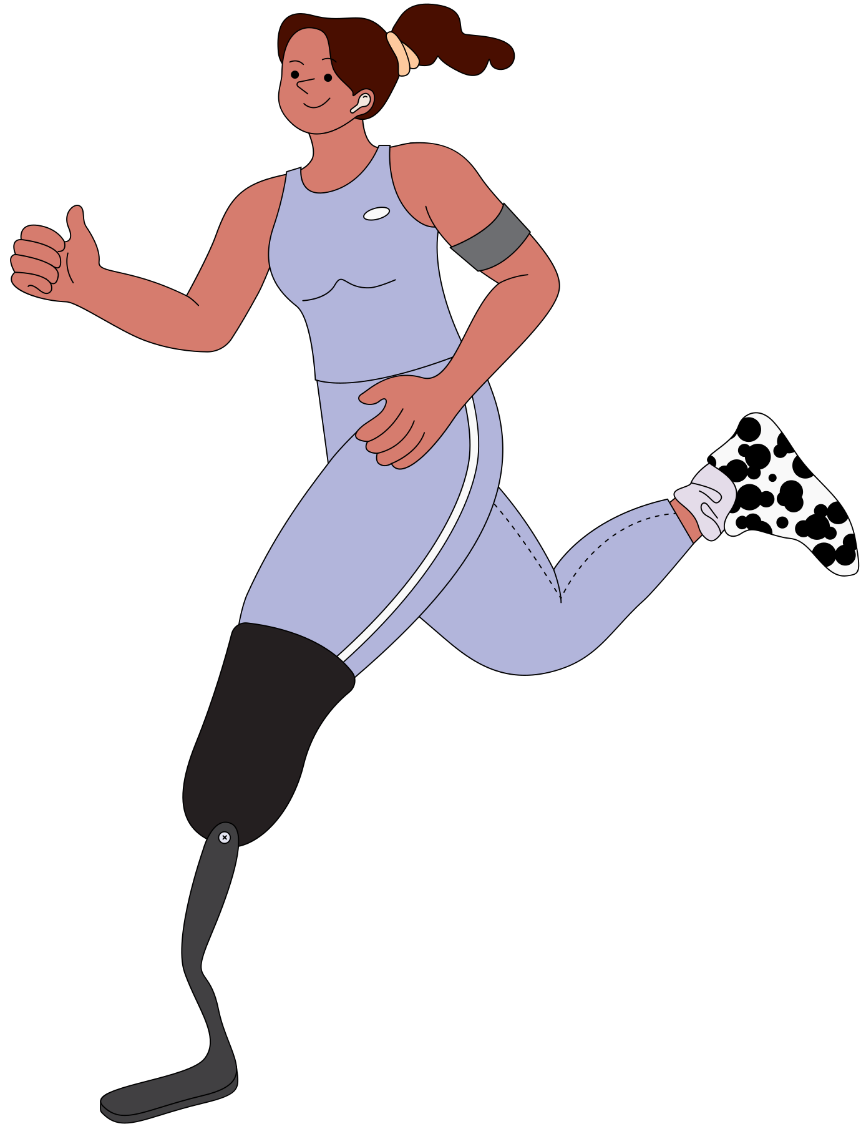
Current Problem
The current issue refers to the limitations encountered by people with motor disabilities.
Prevent their ability to efficiently engage with digital devices and communicate.
These restrictions can have a serious negative effect on their quality of life by making it more difficult for them to engage in social activities, work, and get an education.

Slide 5
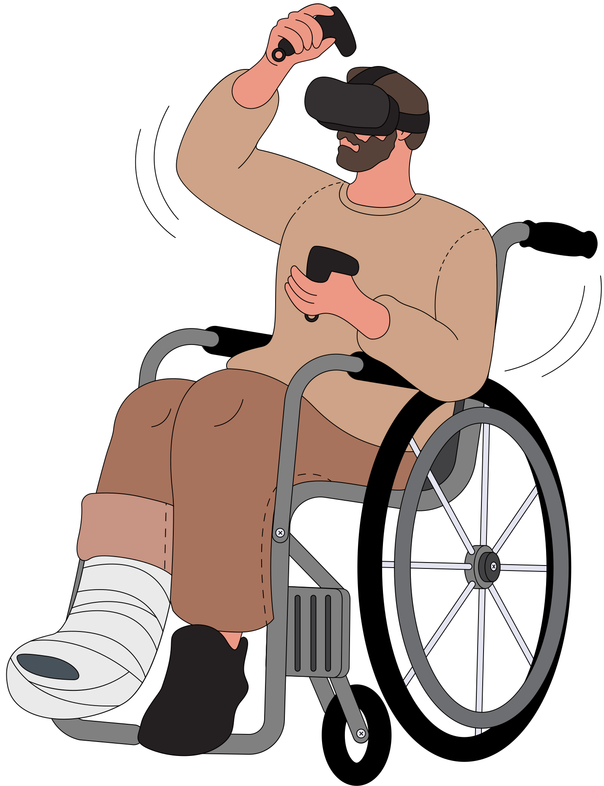
Issue in the Spesific Community
People with motor disabilities, such as paralysis, muscular dystrophy, or limb amputations, make up the particular community under examination.
These people frequently have trouble utilizing conventional input devices, which might make them feel excluded and frustrated.
Their everyday struggles are made worse by the absence of technology that is easily available, which limits their capacity to carry out necessary chores on their own.
By discovering this issue, so we need to recognize the needs of this people.

Slide 6
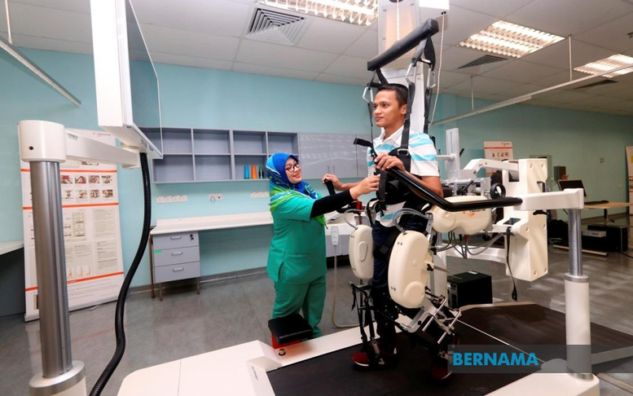
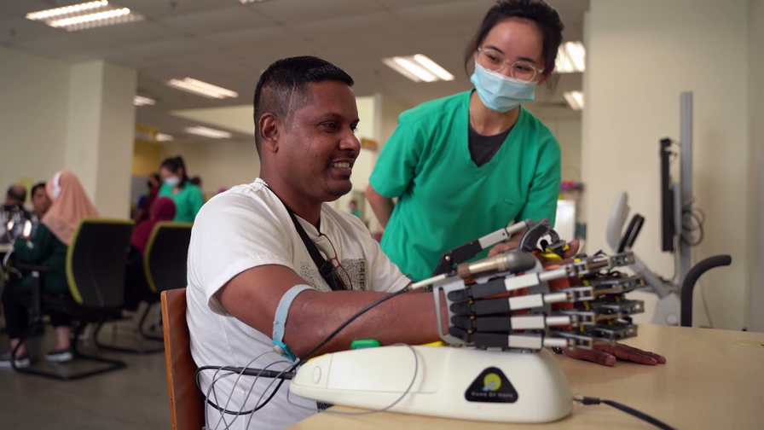
Target Community
Pusat Rehabilitasi Perkeso, Durian Tunggal, Melaka

Slide 7
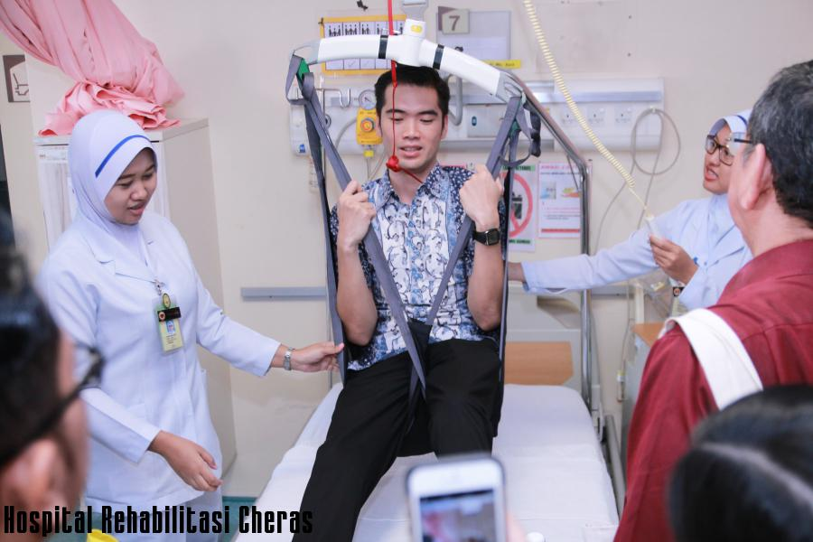
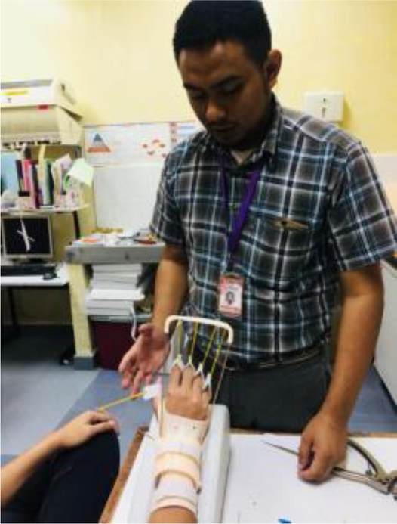
Target Community
Unit Perubatan Rehabilitasi di Hospital Melaka

Slide 8
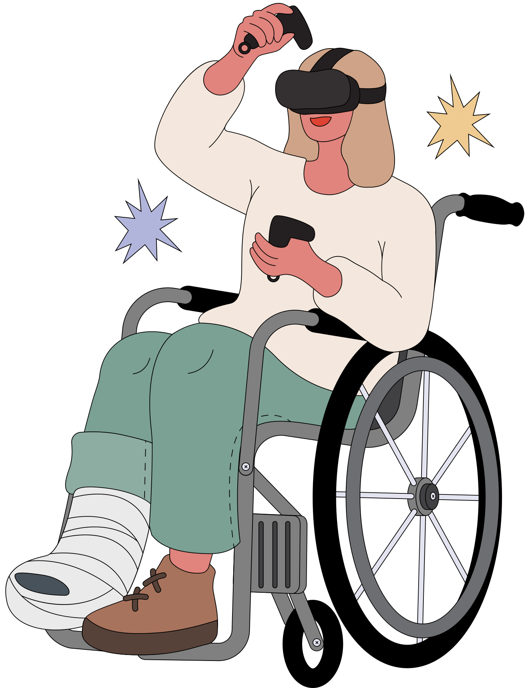
Solution with Artificial Intelligence
The suggested approach involves integrating AI and ICT, namely Bluetooth and radio frequency (RF) connection, to create a gesture recognition system.
Due to this technology, people with motor impairments will be able to operate digital gadgets with hand, finger, and eye blink motions.
In order to provide users with varying abilities with a personalized and flexible interface, the AI algorithms will be trained to recognise a wide range of motions.

Slide 9
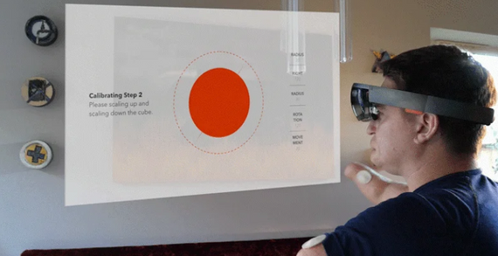
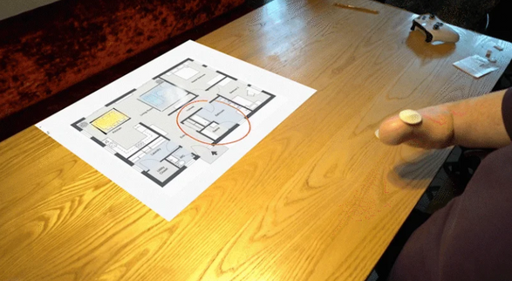
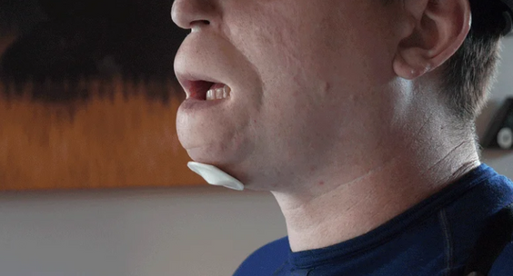
Key Components of the Solution
Gesture Recognition Algorithms:
AI algorithms will be created to accurately interpret hand and finger gestures as well as eye blinks. With ML techniques, and even DL models, the system will be able to adjust to the distinct motions and motor skills of each user.
RF and Bluetooth Communication:
Long-range communication via RF technology will enable consumers to engage with gadgets remotely. Short-range, low-latency communications will be made easier with Bluetooth connectivity, enabling real-time control. Flexibility and accessibility are ensured in a variety of settings by this dual communication technique.
Customization and Adaptability:
Users will be able to design and customize their gestures according to their motor abilities, with customisation being given priority by the system. This flexibility guarantees that people with different degrees of handicap can take advantage of the technology.

Slide 10
Key Components of Business Case
Innovation Competition:
Showcase the unique aspects of your gesture recognition system and how it addresses a critical need in the market. Winning or even participating in such competitions can provide visibility and credibility, attracting potential collaborator.
Network and Industry Event:
ttend relevant industry events and conferences to network with potential collaborators from the corporate sector. Utilize these events to showcase your project, establish connections, and discuss potential collaborations with interested companies
Governments Funding:
Highlight the potential societal impact of the gesture recognition project for motor disabilities and how it aligns with the goals of government initiatives.

Slide 11
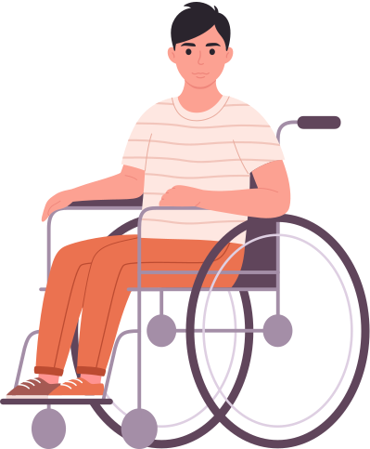
Process Construct

Slide 12




Data Acquisition
Data Processing
Data Extraction
Get data from sensors.
Sensors capture gesture motion and turn it into electrical signals.
Process the acquired data by filtering and reducing noise.
The processed data is then ready for further analysis.
Extract relevant features from the processed data.
Choose features that have a high correlation with the performed gestures.

Slide 13




Gesture Recognition
Evaluation
Comparison & Analysis
Apply machine learning algorithms to classify and recognize gestures.
Algorithms use extracted features to learn patterns and identify gestures accurately.
Evaluate system performance using recognition accuracy and other metrics.
Assess how well the system identifies and classifies gestures, and identify areas for improvement.
Compare and analyze research results with existing methods and literature.
Look at recognition accuracy, types of recognized gestures, dataset size, and experimental design to identify strengths and weaknesses of sensing methods and algorithms.

Slide 14
Monitoring and Controlling
Part 1: Device
Part 2: Community

Slide 15


Monitoring and Controlling Device
Hardware Monitoring
Gesture Recognition Algorithm
User Interface and Experience
Regularly check the hardware components such as sensors, RF modules, Bluetooth modules, and microcontrollers to ensure they are functioning correctly.
Monitor power consumption to ensure that the devices can operate for an extended period without frequent battery changes or recharging.
Monitor the performance of the gesture recognition algorithm. Regularly test the system with different gestures and under various conditions to assess its accuracy and robustness.
Implement debugging mechanisms to identify and address any issues related to gesture recognition.
Evaluate the user interface and overall user experience regularly. Gather feedback from individuals with motor disabilities who use the system to identify any areas that need improvement.
Monitor the responsiveness of the system to ensure that gestures are recognized promptly and accurately.

Slide 16
Monitoring and Controlling Community
Public Announcement
User Testimonials and Stories
Community Forums and Q&A
Regularly share project updates, milestones, and achievements through public announcements. This could be done through press releases, blog posts, or updates on the project website.
Share user testimonials and success stories to highlight the positive impact of the project on individuals with motor disabilities. This can create a compelling narrative and generate community support.
Create or participate in community forums related to assistive technology, motor disabilities, or technology for social good
Respond promptly to questions and feedback from community members to build trust and credibility.

Slide 17
Planning
Work Breakdown Structure
Scope Statement
Cost Estimation

Slide 18
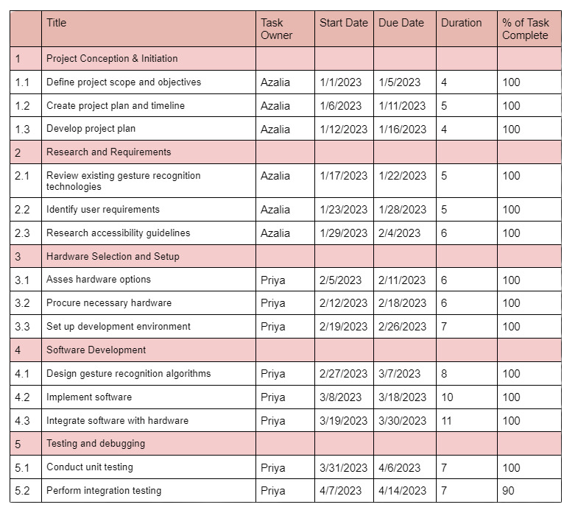
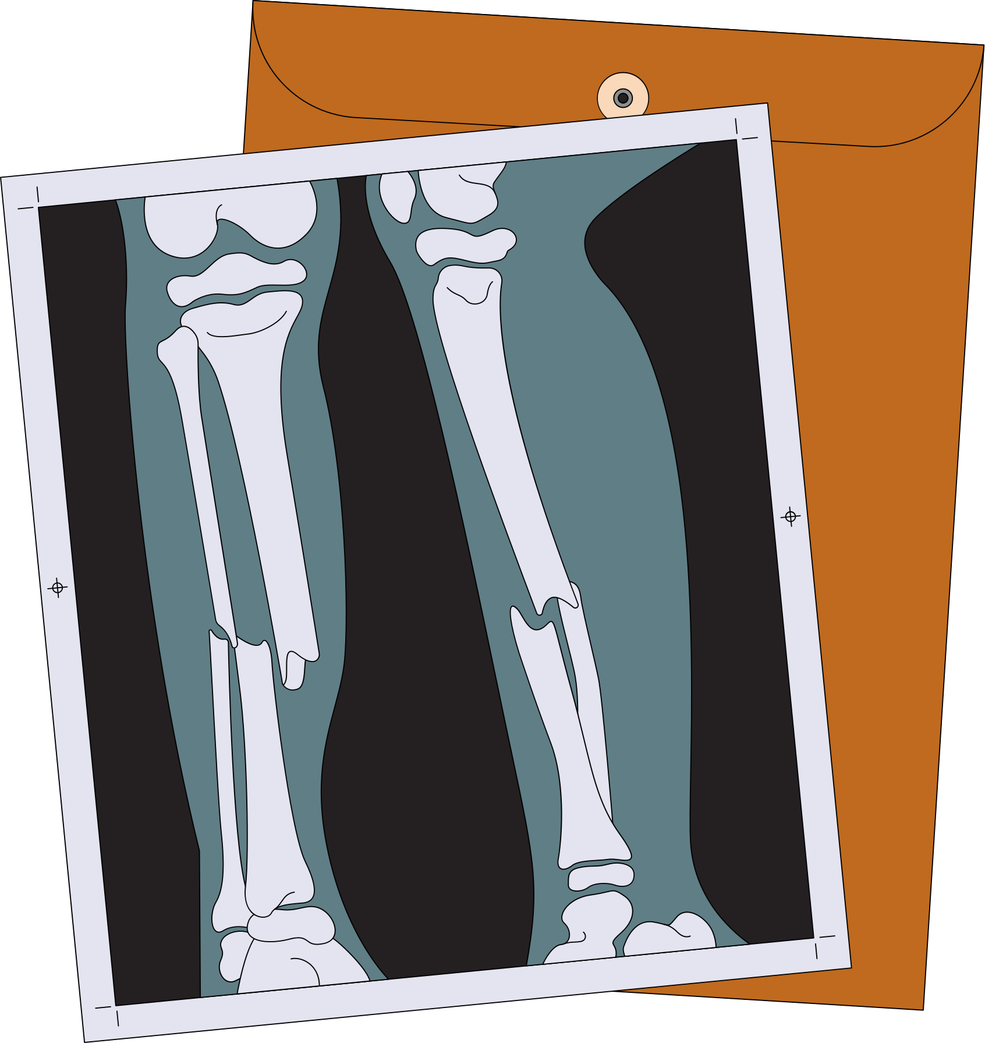

Slide 19
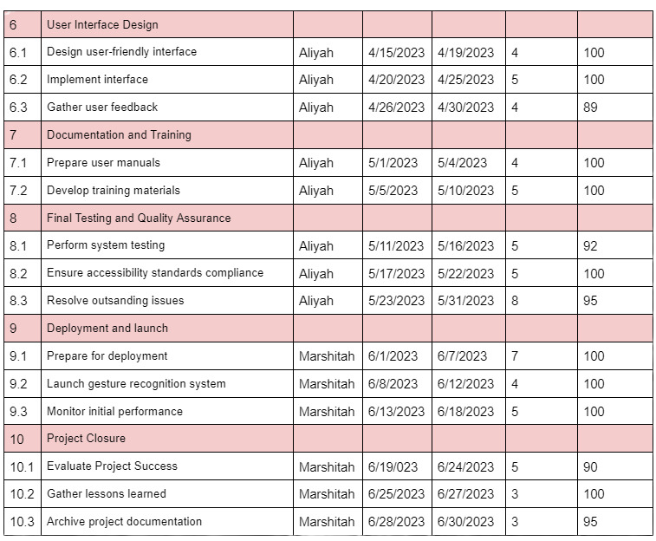

Slide 20
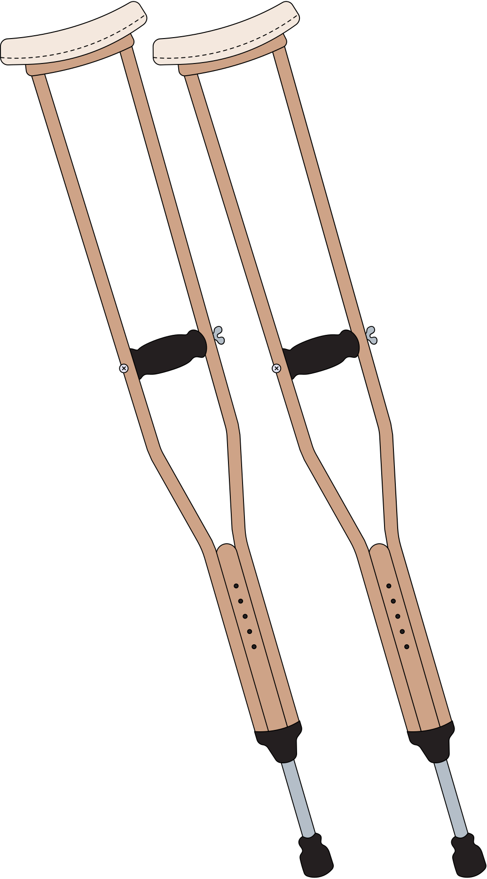
scope :
Assistive Technology for Motor Disabilities:
Develop a cutting-edge gesture recognition system to assist individuals with motor disabilities in interacting with electronic devices.
Customizable Gesture Library:
Implement a diverse library of hand and finger gestures that users can easily customize based on their specific needs and abilities.

Slide 21
Hands-Free Device Interaction:
Enable hands-free interaction with smartphones, tablets, computers, and other electronic devices through recognized gestures.
Communication Accessibility:
Improve communication for individuals with motor disabilities by translating recognized gestures into meaningful commands or text.

Slide 22
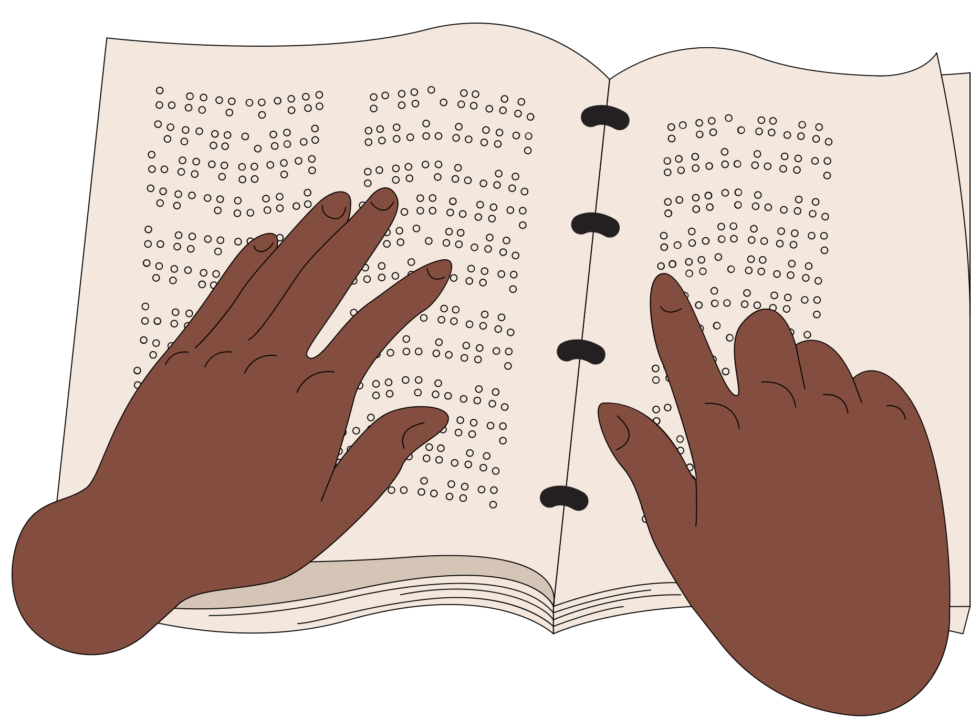
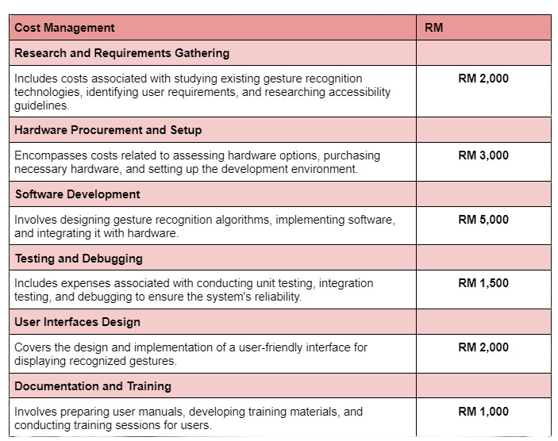
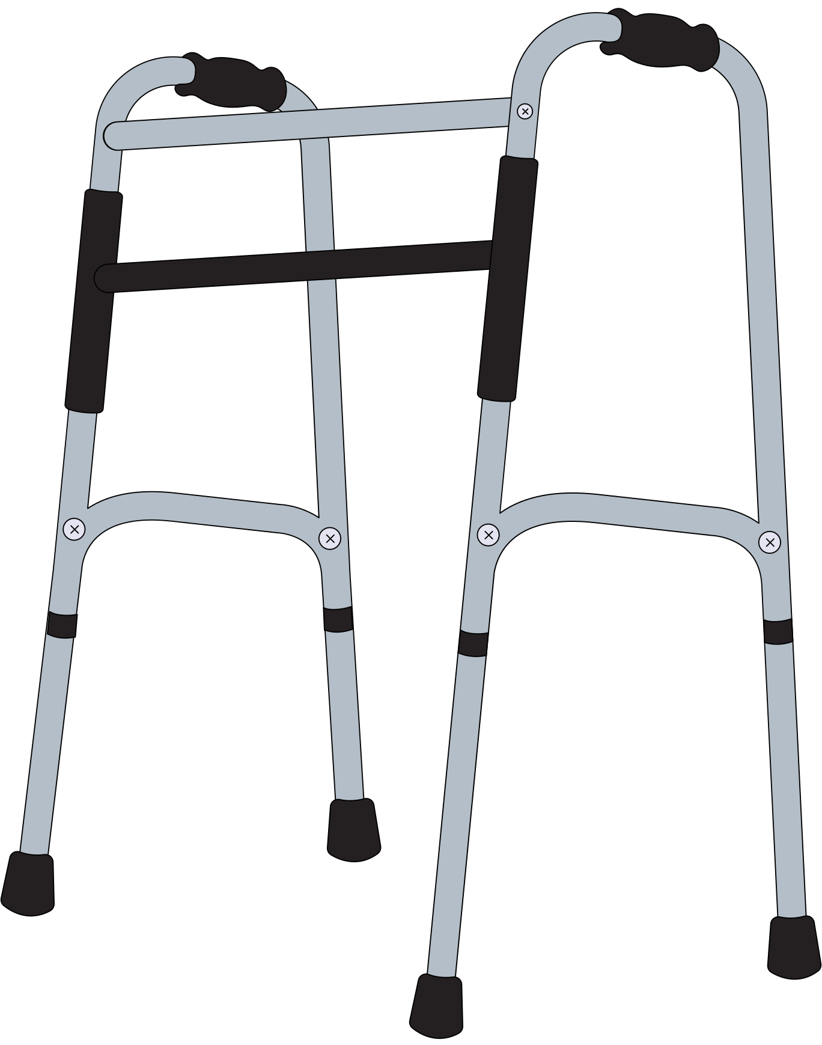
COST ESTIMATION

Slide 23
